Slide 1
Secure Data Hiding in Image Using Steganography
CAPSTONE PROJECT
Presented By:
Student Name : BHARATH T
College Name & Department : Department Of Computer Science And Application, Reva University, Bengaluru

Slide 2
OUTLINE
Problem Statement
Technology used
Wow factor
End users
Result
Conclusion
Git-hub Link
Future scope

Slide 3
Problem Statement
In today's digital era, protecting sensitive information is more critical than ever. Conventional encryption techniques can attract unwanted attention, increasing the risk of interception. Image Steganography offers a discreet method to conceal messages within images, enabling secure communication without arousing suspicion. This project focuses on developing an intuitive web application that empowers users to seamlessly hide and retrieve encrypted messages within images.

Slide 4
Technology used
Programming Language:
Python – Backend logic and image processing
Backend Framework:
Flask – Lightweight web framework for handling requests
Frontend Technologies:
HTML, CSS (Bootstrap) – Responsive web UI
Libraries Used:
OpenCV – Image processing for encryption & decryption
NumPy – Efficient array manipulation
Tkinter – GUI for standalone script execution (optional)
Platforms & Tools:
Git & GitHub – Version control & collaboration
Jinja2 – Template engine for Flask
Heroku / Render / Localhost – Deployment options

Slide 5
Wow factors
What Makes This Image Steganography Web App Unique?
Intuitive Web Interface
Unlike conventional steganography tools that require command-line expertise, this project offers a simple, user-friendly web-based UI powered by Flask, making it accessible to everyone.
Passcode-Protected Security
To enhance privacy, the hidden message is secured with a custom passcode, ensuring that only authorized users can decrypt and retrieve the concealed information.
Minimal Image Alteration
Unlike many techniques that significantly distort images, this project maintains visual integrity by subtly embedding data, making detection nearly impossible.
Covert & Secure Data Transmission
The hidden message is embedded directly within the image, eliminating the need for separate encrypted files and reducing the risk of interception or suspicion.
Cross-Platform Compatibility
Runs smoothly on Windows, Linux, and macOS without requiring complex installations or additional dependencies.
Efficient & Lightweight Processing
This tool optimizes steganographic encoding to ensure:
Rapid encryption & decryption
Minimal increase in file size while maintaining data integrity

Slide 6
End users
Journalists & Whistleblowers – Transmit confidential information discreetly while avoiding detection.
Government & Intelligence Agencies – Enable secure, covert communication for classified operations.
Cybersecurity Professionals & Enthusiasts – Explore and implement cryptographic security techniques for data protection.
Everyday Users – Securely hide personal messages in images for private communication.

Slide 7
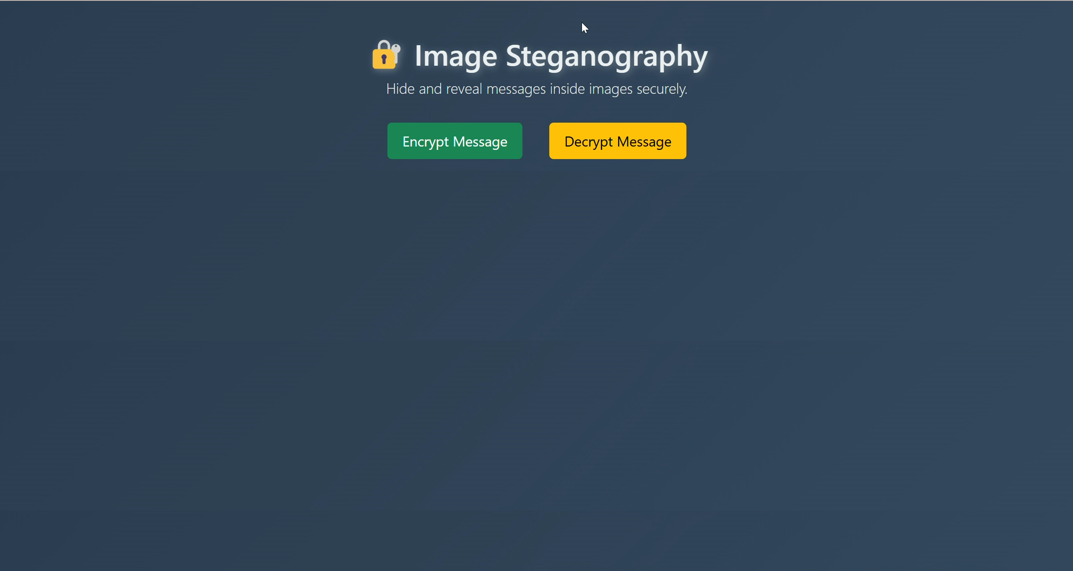
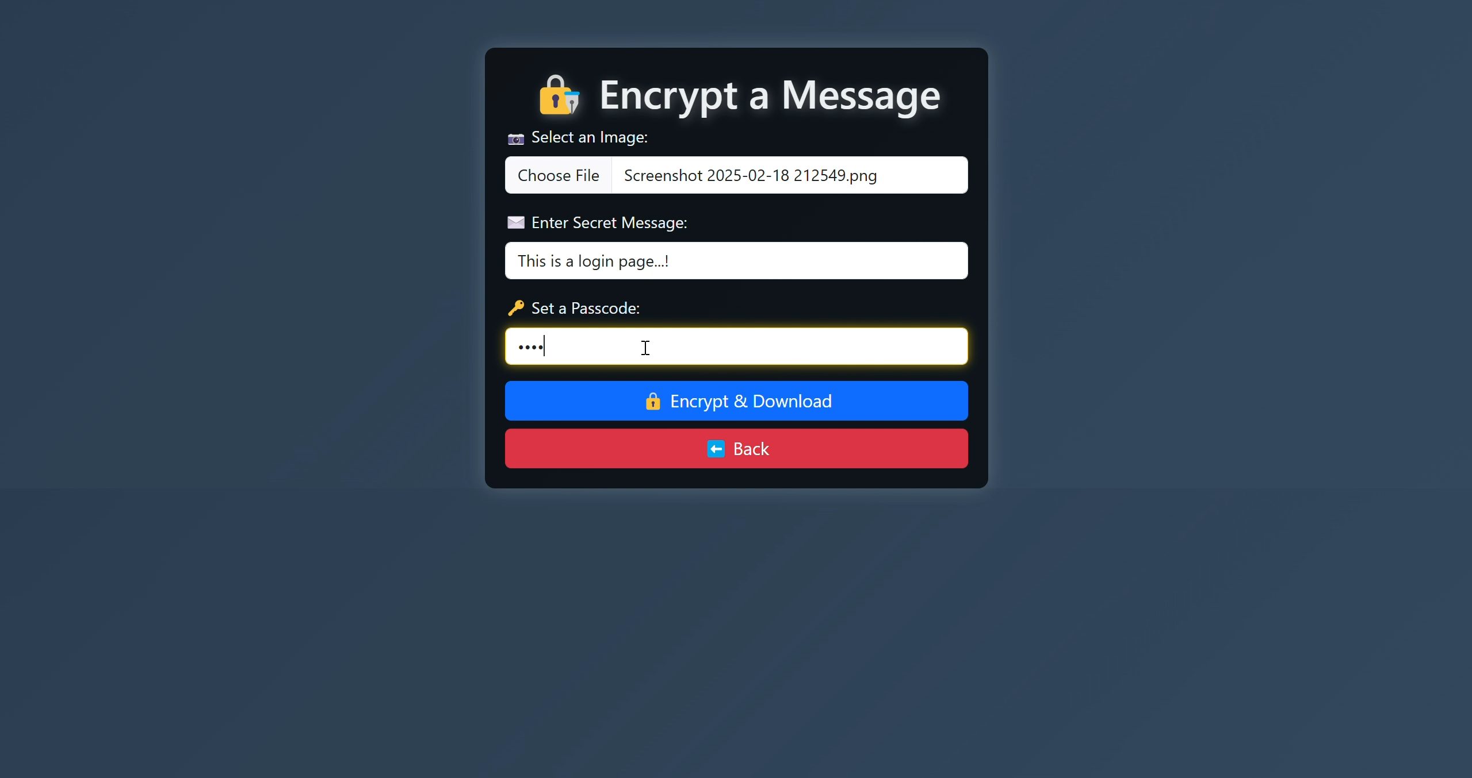
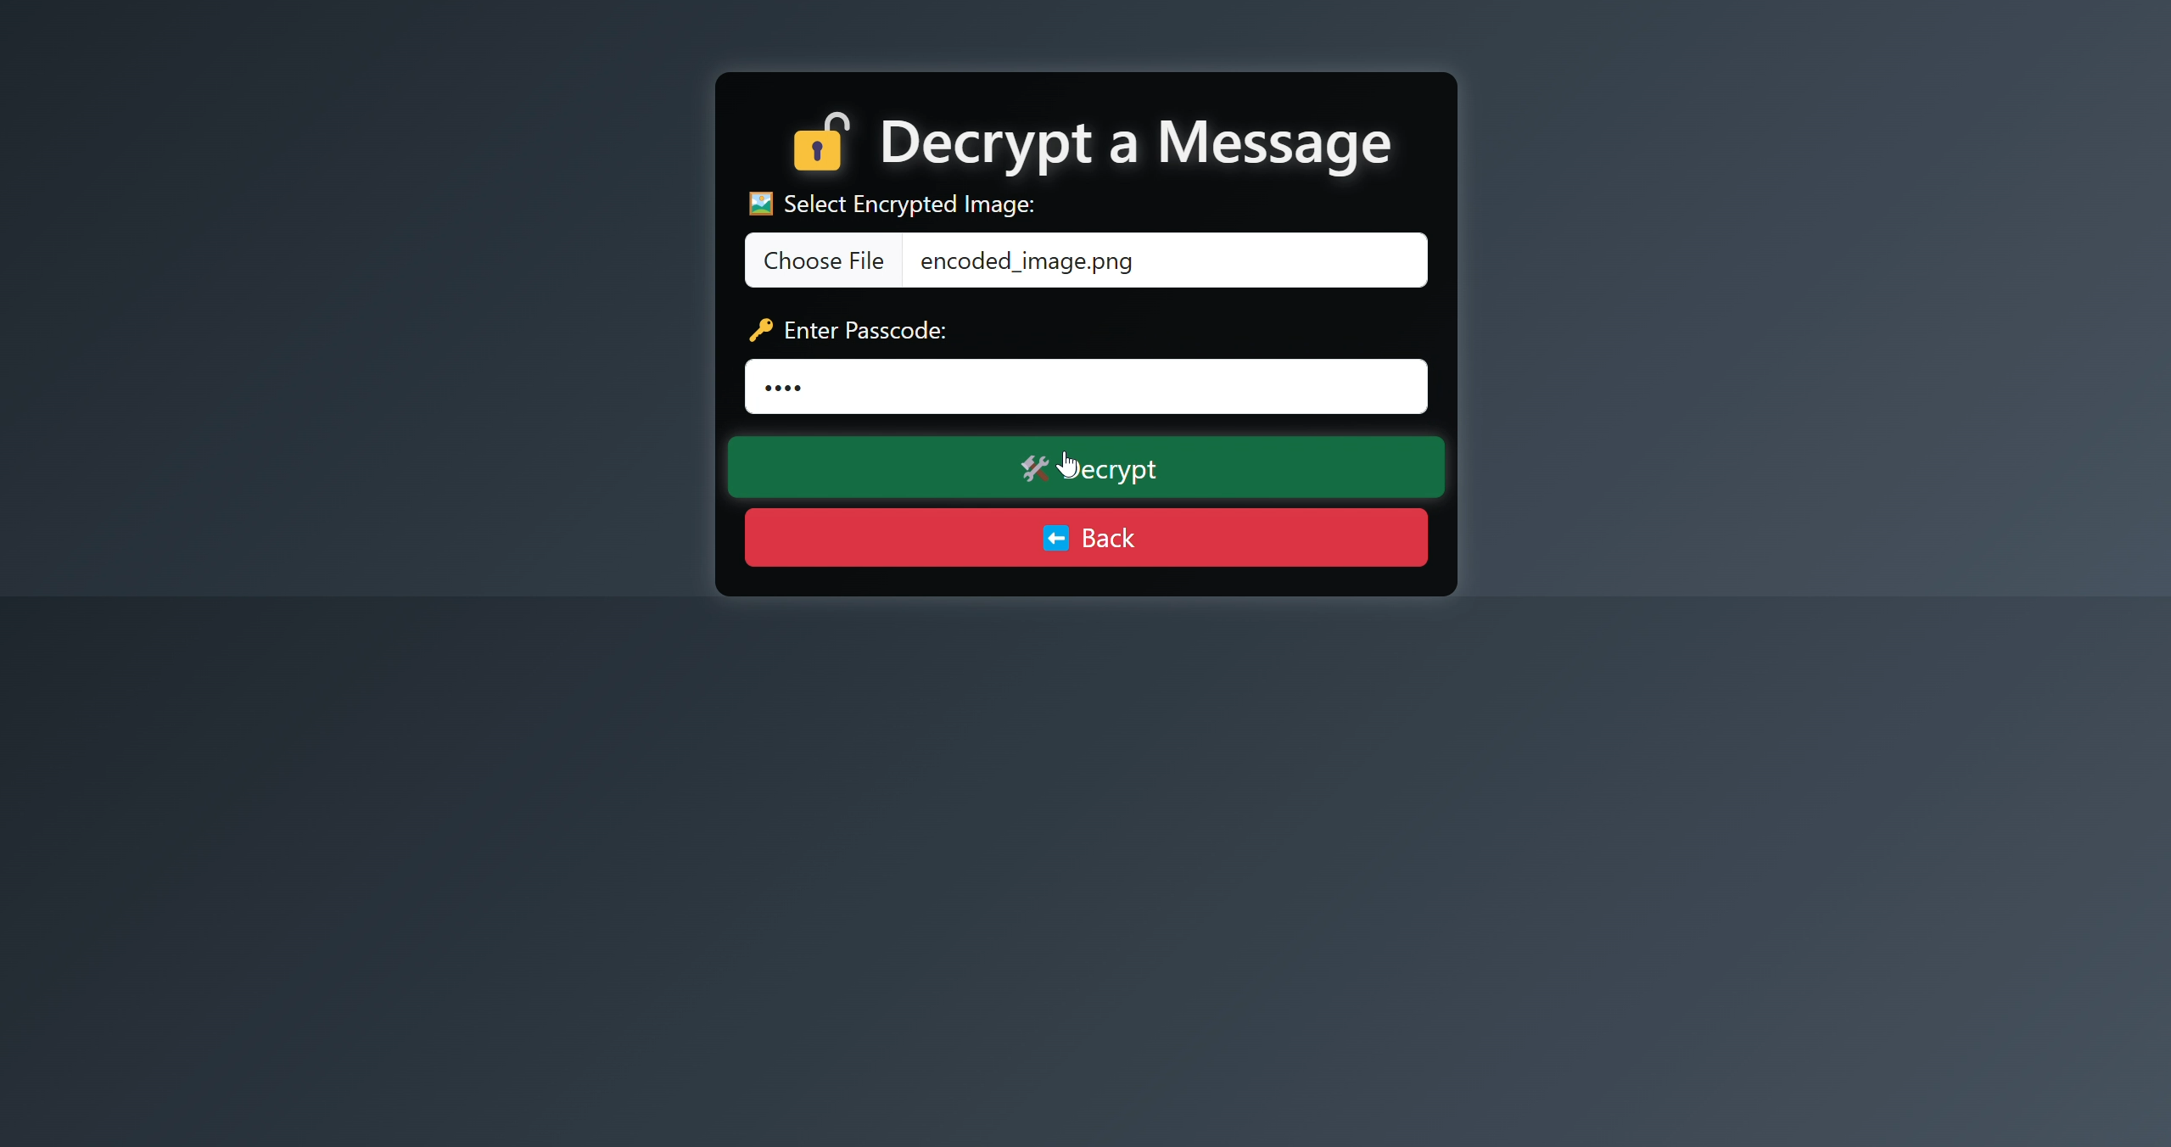
Results

Slide 8
Video demonstration link
https://drive.google.com/drive/folders/1Dlc8kAuAAWGubckOnjvmlnfCqqYmes4K?usp=sharing

Slide 9
Conclusion
This Image Steganography Web App effectively tackles the challenge of secure message transmission by embedding hidden text within images without visible alterations. Unlike conventional encryption techniques that might draw suspicion, steganography enables covert communication, making it a valuable tool for cybersecurity, data privacy, and secure messaging.
By leveraging Flask, OpenCV, and passcode protection, this project ensures that only authorized individuals can access the hidden information. The web-based interface simplifies usage, eliminating the complexity of command-line tools and making steganography accessible to all users.
In summary, this project presents a lightweight, secure, and efficient approach to concealed data transmission. Looking ahead, potential enhancements such as AI-driven image security, mobile app development, and cloud-based encryption could further expand its real-world applications in the realm of digital security and private communication.

Slide 10
GitHub Link
https://github.com/MR-BHARATH-T/Steganography

Slide 11
Future scope
AI-Powered Image Analysis – Implementing machine learning to detect and enhance steganographic security.
Expanded Format Compatibility – Supporting additional image formats like BMP, GIF, and more for greater flexibility.
Mobile Application Development – Bringing steganography to Android & iOS for secure messaging on the go.
Cloud-Based Encryption – Enabling secure storage and retrieval of steganographic images through cloud integration.
Blockchain-Powered Security – Utilizing decentralized networks to ensure tamper-proof and transparent message transfers.

Slide 12
THANK YOU

